Slide 1
Normalized Device Coordinates (NDC)
and clipping
Advanced Graphics Programming

Slide 2
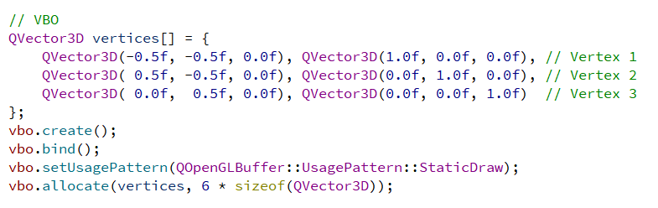
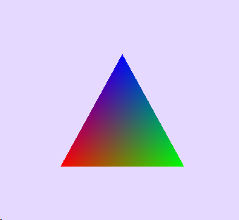
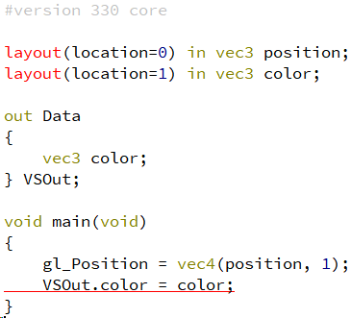
NDC (Normalized Device Coordinates) and clipping
Vertex buffer object
Positions
In the previous example, we specified some coordinate values and the triangle appeared in the middle… why?
Vertex shader (VS)
And the vertex shader was not transforming those coordinates...

Slide 3
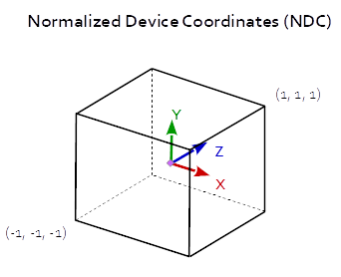
NDC (Normalized Device Coordinates) and clipping
The GPU works in Normalized device coordinates
Corners
(-1, -1, -1)
(1, 1, 1)
After all vertices are transformed, only geometry within this volume is visible.
Maps to the viewport.
Why NDC???

Slide 4
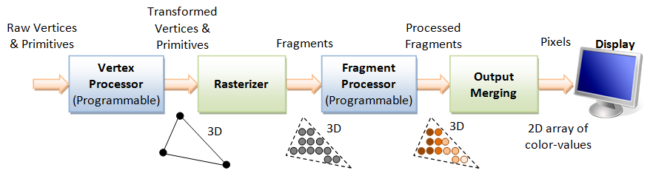
NDC (Normalized Device Coordinates) and clipping
Remember the (simplified) rendering pipeline?
Between these two stages, more stuff is happening

Slide 5
NDC (Normalized Device Coordinates) and clipping
Remember the (simplified) rendering pipeline?
Vertex shaders
Tessellation shaders
Geometry shaders
NDCs are efficient for clipping
Graphics pipeline
Clipping /
Face culling
Rasterization
Between these two stages, more stuff is happening
Fragment shaders

Slide 6
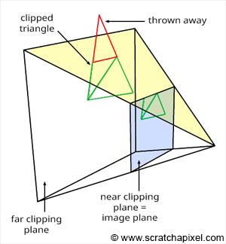
NDC (Normalized Device Coordinates) and clipping
The clipping stage clips non-visible geometry so that only fragments belonging to the viewport are generated
But this actually happens after transforming and projecting all vertices, when they are in NDC (very efficient in GPUs).
Triangle parts outside the view frustum are removed...

Slide 7
NDC (Normalized Device Coordinates) and clipping
Vertex buffer object
Positions
Vertex positions are directly specified in normalized device coordinates NDC.
Vertex shader (VS)
As the VS does not transform vertex positions, the triangle appears directly as specified in the VBO.

